Slide 1

Aqueduct Village
Reimagining the Aqueduct Racetrack Footprint as an Innovative Vanadium Flow Battery (VRFB) Campus, Stormwater Aqueduct Park, and Affordable Housing Ecosystem
A COMMUNITY EQUITY & CLIMATE RESILIENCE PROPOSAL FOR SOUTH QUEENS

Slide 2




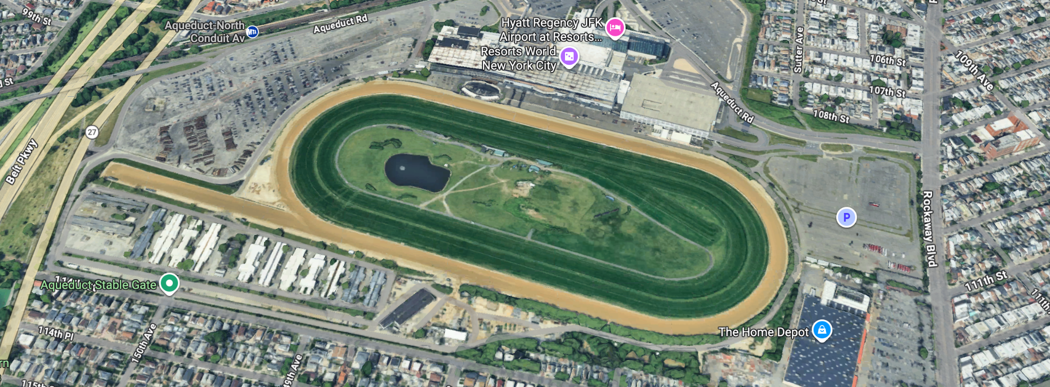
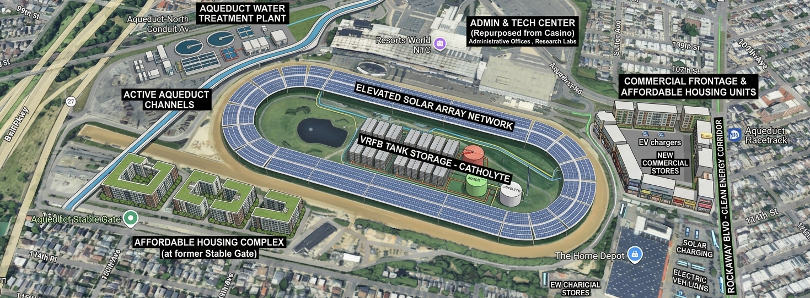
Reimagining Aqueduct
Current Site Footprint
The Regenerative Future
The underutilized Aqueduct Racetrack and stables in Queens presents a vast, concrete-heavy acreage vulnerable to climate challenges.
A reimagined eco-tech master plan showcasing long-duration energy storage, integrated solar, stormwater capture, and affordable housing.

Slide 3





Four Resilient Pillars
Grid-Scale VRFB
Solar Canopy
Flood Mitigation
Utility-scale Vanadium Redox Flow Battery installation providing deep, non-degrading, safe energy storage directly back into the local South Queens microgrid.
A massive integrated solar array built above the battery units, feeding clean, localized power to offset peak reliance and fuel local grid circuits.
Beautiful active aqueduct channels carving through the central park to collect stormwater runoff, draining directly into a municipal filtration plant.

Slide 4

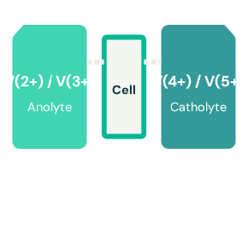
Vanadium Flow Storage
Safe, Urban-Grade Battery Tech
Zero Fire Risk: Unlike lithium-ion, water-based VRFB electrolyte cannot catch fire, eliminating safety hazards in high-density areas.
25+ Year Lifespan: Flow batteries experience practically no capacity degradation, operating reliably for multiple decades.
Infinite Recyclability: At end-of-life, the non-toxic vanadium liquid can be easily filtered and reused in other facilities.

Slide 5
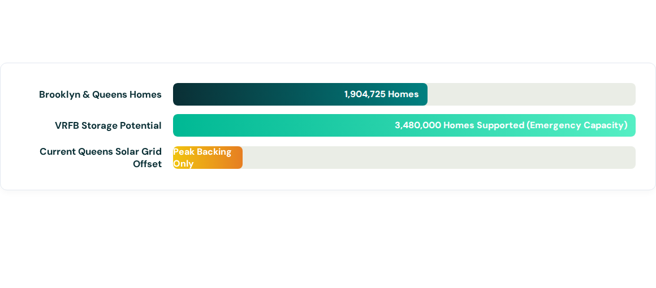
Local Energy Capacity
The strategic volume of flow storage possible on the oval site holds the potential to prevent massive blackouts across the Southern Queens grid corridor, generating and storing excess municipal clean power.

Slide 6


Active Stormwater Park
Stormwater Aqueducts
Rear Water Filtration Plant
Historically plagued by tidal and precipitation flooding, South Queens streets will be protected by a series of open aqueduct channels winding directly through the old racetrack oval.
Runoff collected via the central aqueduct channels is fed into a highly modern, quiet, low-footprint water filtration center placed discreetly at the back of the property.
These natural bioswales catch, slow, and divert millions of gallons of urban runoff during high-intensity rain events, transforming risk into local landscape features.
This filtered water is recycled back into local municipal networks, landscape irrigation, and safe gray-water systems for the community housing blocks.

Slide 7

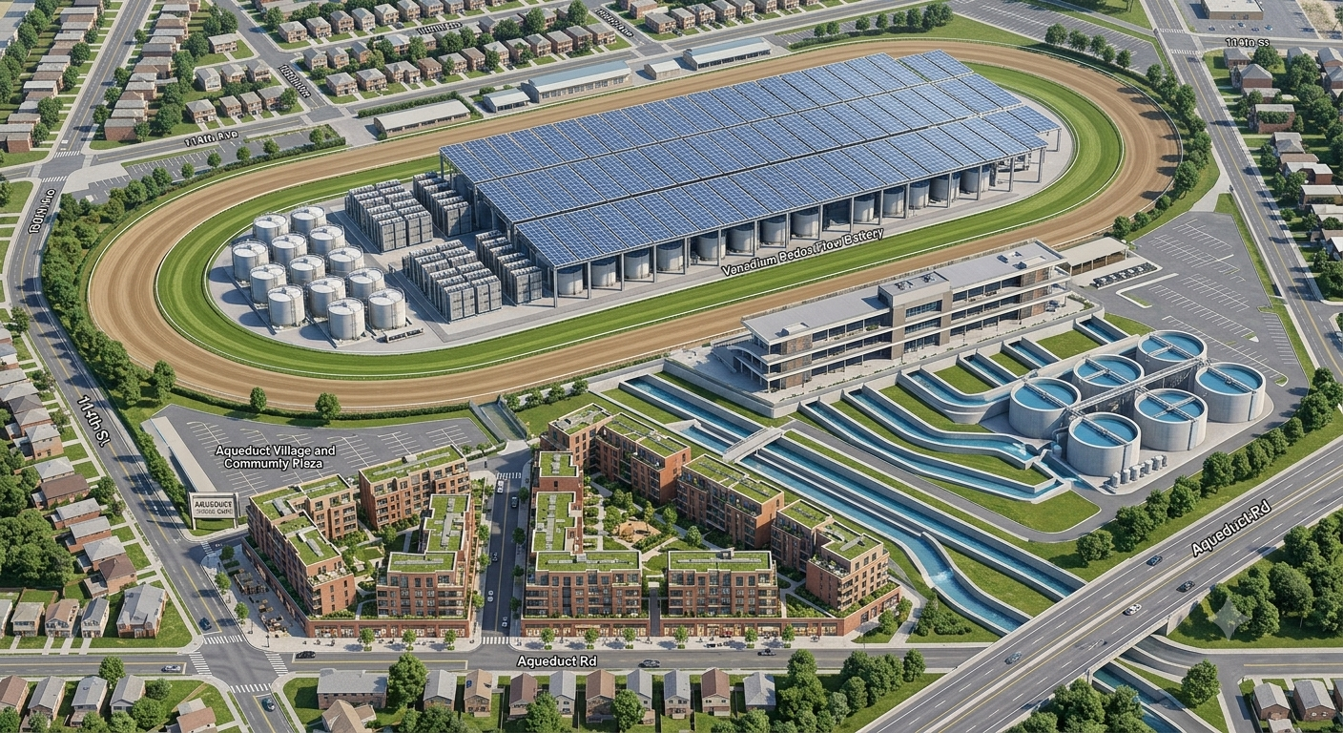
Affordable Eco-Housing
Community-First Spaces
The old racetrack stable region is reimagined as a vibrant residential corridor, placing human needs alongside green infrastructure.
Street-level store frontages line Rockaway Avenue, creating space for locally-owned retail shops and community-based health and childcare services.

Slide 8
Municipal Power Arbitrage
Reducing Local Cost of Ownership
$24M+
By implementing a community land trust model, the Aqueduct Village would directly own the solar generation and the flow storage reserves.
By buying power from ConEd and National Grid when rates are cheap (off-peak overnight) and selling it back to the grid during emergency periods of high demand, the facility can offset its own operating expenses and fund the local housing trust.
Est. Annual Revenue Potential

Slide 9




Development Roadmap
Phase 2: Storage
Phase 4: Housing
Phase 1: Planning
Excavation, installation of the core VRFB electrolyte tank units, and erection of the structural solar canopy frame.
Phase 3: Water
Erecting the affordable mixed-use apartments and streetfront retail spaces, handing keys to the community trust.
Community reviews, architectural feasibility, municipal zoning adjustments, and environmental site design.
Construction of stormwater aqueducts, localized retention parks, and building the back-end filtration facility.

Slide 10
Let's Power Queens Together
What if Aqueduct could truly give back to the community?
South Queens Sustainable Development Initiative
Email: contact@aqueductvillageplaza.org | Web: www.aqueductvillageplaza.org

